Slide 1
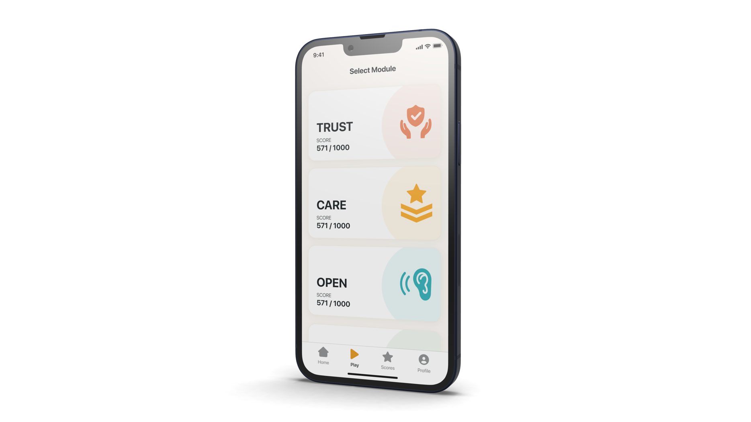
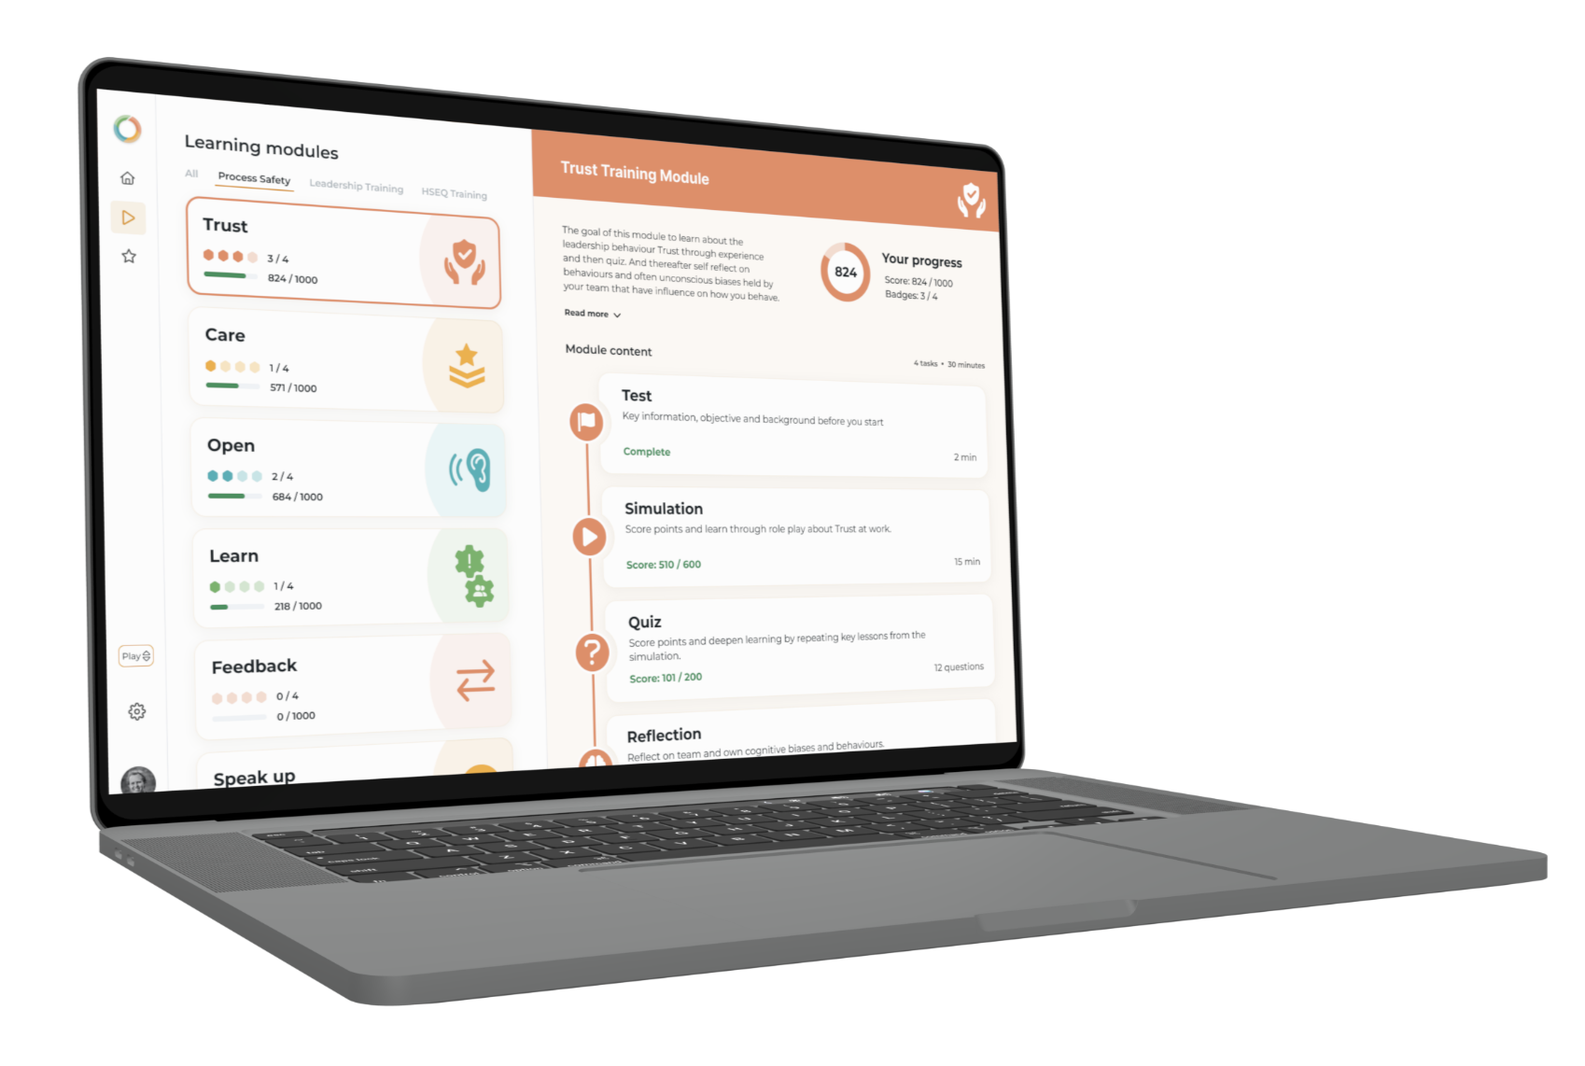

SAYFR
- the science behind
XLAB page 5, 6 and 7

Slide 2
SAYFR is a company based in Oslo, Norway assisting clients implementing cultural change, improving safety performance and reducing major accident risk.
1. Understanding the problem
Thought leaders have identified dysfunctionalities (lack of engagement, continuous improvement not working, recurring accidents and under-reporting) in the existing safety regime. They are promoting new safety principles, however, tools and means for effective implementation are lacking. Real changes require changes of habits on a large scale, something most organizations have little experience with.
2. Implementing change at scale
Based on science and unique data from more than 300 000 employees in global safety conscious companies, SAYFR has now launched its 4th generation digital platform. This platform supports benchmarking of behaviors and a game-based approach to change habits by involving all employees through their personal mobile devices, as a means to solve above mentioned dysfunctionalities.
For more information, check out or web page: www.SAYFR.com

Slide 3
Eight Leadership Behaviours have Proved to Describe the Ability to Mange Failures
TRUST
OPENNESS
FEEDBACK
TEAM
See the value of and have confidence in other people. Believing that people act with good intentions (and without hidden agendas), even when they act and think in a way that is different from you.
Be open for the possibility that no-one (not even you) are right and that this might have severe consequences. Be open for feedback from others.
Give personal feedback to show that you see, understand and appreciate what people around you do. Give critical feedback without blame or causing shame.
Collaborating towards common goals and agreed norms, while helping each other in becoming better in the process.
CARE
LEARN
SPEAK-UP
DILEMMAS
Take ownership of your job by resolving problems and manage failures, even when they are outside of your formal role. Show colleagues that you care about their wellbeing.
Having the attitude that you can always learn something new, and to see failure as a vital source of learning.
Speak up if you observe non-compliance, hazards or if you have any concerns. Encourage and empower others to do the same.
Seek out and manage failures arising from conflicts and dilemmas between goals, policies and people.

Slide 4
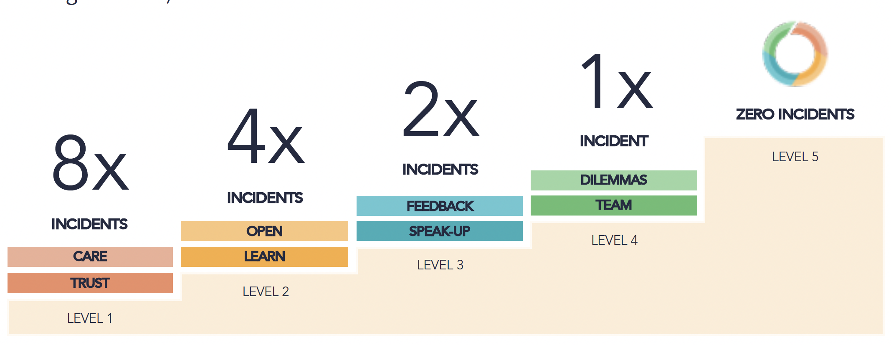
Objective of program
SAYFR methodology aligns well with Statkraft’s HSS ambitions and behaviors.
SAYFR’s products offers:
A combination of science, culture measurement and digital tools to enhance the HSS work culture.
Flexibility to build upon existing safety initiatives in Statkraft
Opportunities to add momentum, bring inspiration and include new ideas in Statkraft’s HSS culture development.
Traditional measures to control major accident hazards consists of training to build competent people, tools to manage risks and procedures. However, still failures will happen. The key is to capture learning from these failures to learn and improve, before the failures can escalate into major incidents. In close to all major incidents, the failures causing them were known before the incident took place. This implies that a more mature culture that effectively manage failures could have prevented these incidents from taking place..
The objective for the service to be offered by SAYFR is to help Statkraft in strengthening culture, risk management and learning in an organization that has grown and continue to grow.
Statkraft has chosen to pilot the Cultiv8 concept to explore SAYFR’s methodology in developing and enhancing HSS culture.

Slide 5
We offer a digitalized change, OTJ
XLAB
Top-down approach for leaders
- 80% reason for effective change
Bottom-up approach for teams
- 80% reason for efficient change
Growth oriented psychometric tests
By utilising preference profiles, leaders can calibrate their behaviours making them more capable to be role models.
On the job leadership missions
By using on the job missions, leaders get support to try out behaviours in real life and On The Job (OTJ).
XLABS to get key managers onboard
Managers gets prepared in and eXperience LAB to facilitate the development process and use the digital tools in practise. This makes the process self managed.
Gamified simulations on web-app
Utilising gaming technology allows individuals to try out using behaviours in a 3D simulation and get motivated by points and high score lists. Reaching employees on their personal means that all employees can simultaneously play and learn anytime anywhere.
Team reflections to act on the job.
The game scenarios in the 3D simulation are used as a basis for open discussion about choices and judgement with same reference points. Utilising reflection questions and action cards that matches the maturity of the organisation or team in questions helps to create collective improvement.

Slide 6
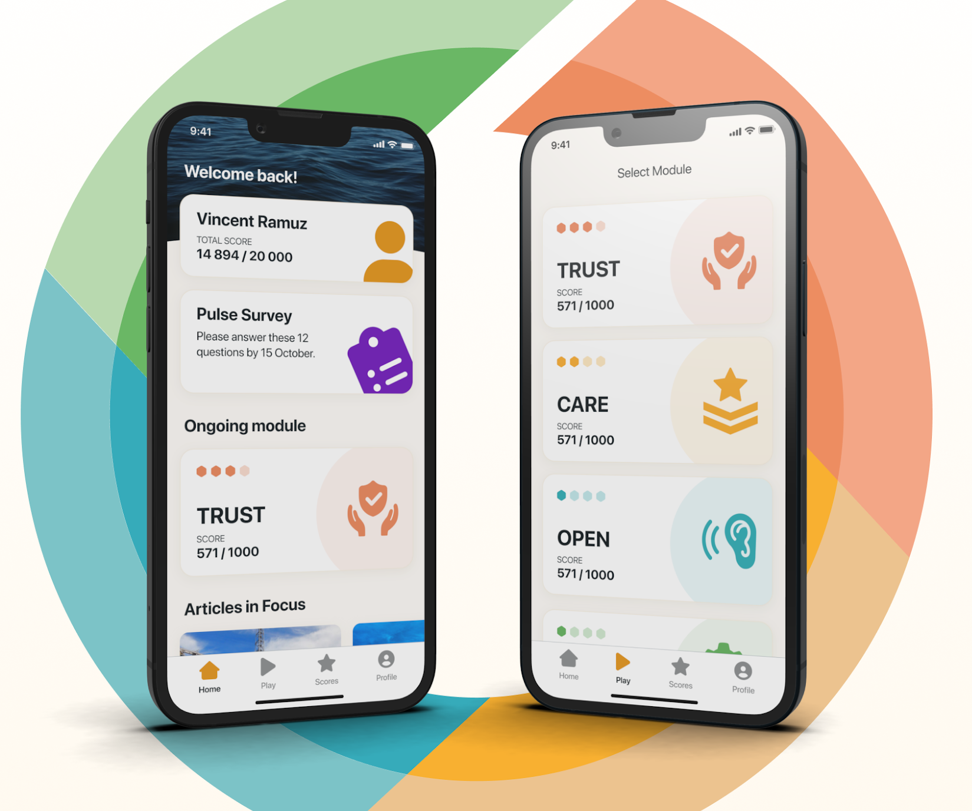
XLAB Leadership Training week 10 & 11
Leaders in Peru, Turkey and Spain will be part of XLAB leadership training.
First part is an Online Workshop hosted live through a Zoom link.
Second part is two one-to-one coaching sessions with a professional coach.
In order to participate in these, the leaders have to sign up.
In the online workshop and coaching session, they will learn how to be good facilitators and how to use the Cultiv8 app.
Kick-Off Meeting 25th January
Safer Together

Slide 7
XLAB
Prepare Leaders
SAYFR’s ambition is to leverage the existing organisation as much as possible. This implies use of an internal project manager and strategy, processes, visual identity and arenas. To get started, the leaders need to be prepared and mobilized. The activities to prepare leaders cover:
Onboarding of project manager and other key managers
Create draft roadmap for the program linking the program to strategy
Communication plan
XLABs to all key managers
XLABs: The largest activity within preparation of leaders, is what we refer to as the eXperience Labs (XLABs). Originally, this was done in a three-day process in a class-room setting. Under the pandemic, this has been transformed into an approach based on webinar and video-communications meetings. First, there is a 2,5 hours webinar led by 3 external facilitators. The webinar also consists of 3 individual breakout rooms for group discussions and reflections sharing. During the next week and a half, an executive coach has 2 1:1 meetings with the individual leaders. This leadership development process has obtained very good feedback. Some companies run 10% of their people through this process, while others choose to include only key employees through the process.
150 MIN
45 MIN
45 MIN
Homework 1
Homework 2
WEBINAR 1
READBACK WITH COACH
COACHING 2
Access to the Cultiv8 web-app:
Pre-read material
The SAYFR Sciences behind
Welcome to the program
Tips to Facilitators
Facilitated by SAYFR/Kulturkompaniet
Insight into Leadership behaviours and their importance for company culture
Interactive sessions and discussions related to body language and behaviour – and their effect on working environment and group dynamics
1:1 Coaching session between the leader and a certified coach. Based on results from Type-test
Second coaching session:
App tools and further preparation work
Coaching related directly to Facilitation and Leading good team Sessions
Homework 1 = do Type Test in app
Homework 2 = prepare for leading team Sessions in app

